Slide 1

ST625 NYC Property Sales
Anna, Jesse, Kirat, Mickey, Renata, Spencer
Notes:
Spencer

Slide 2
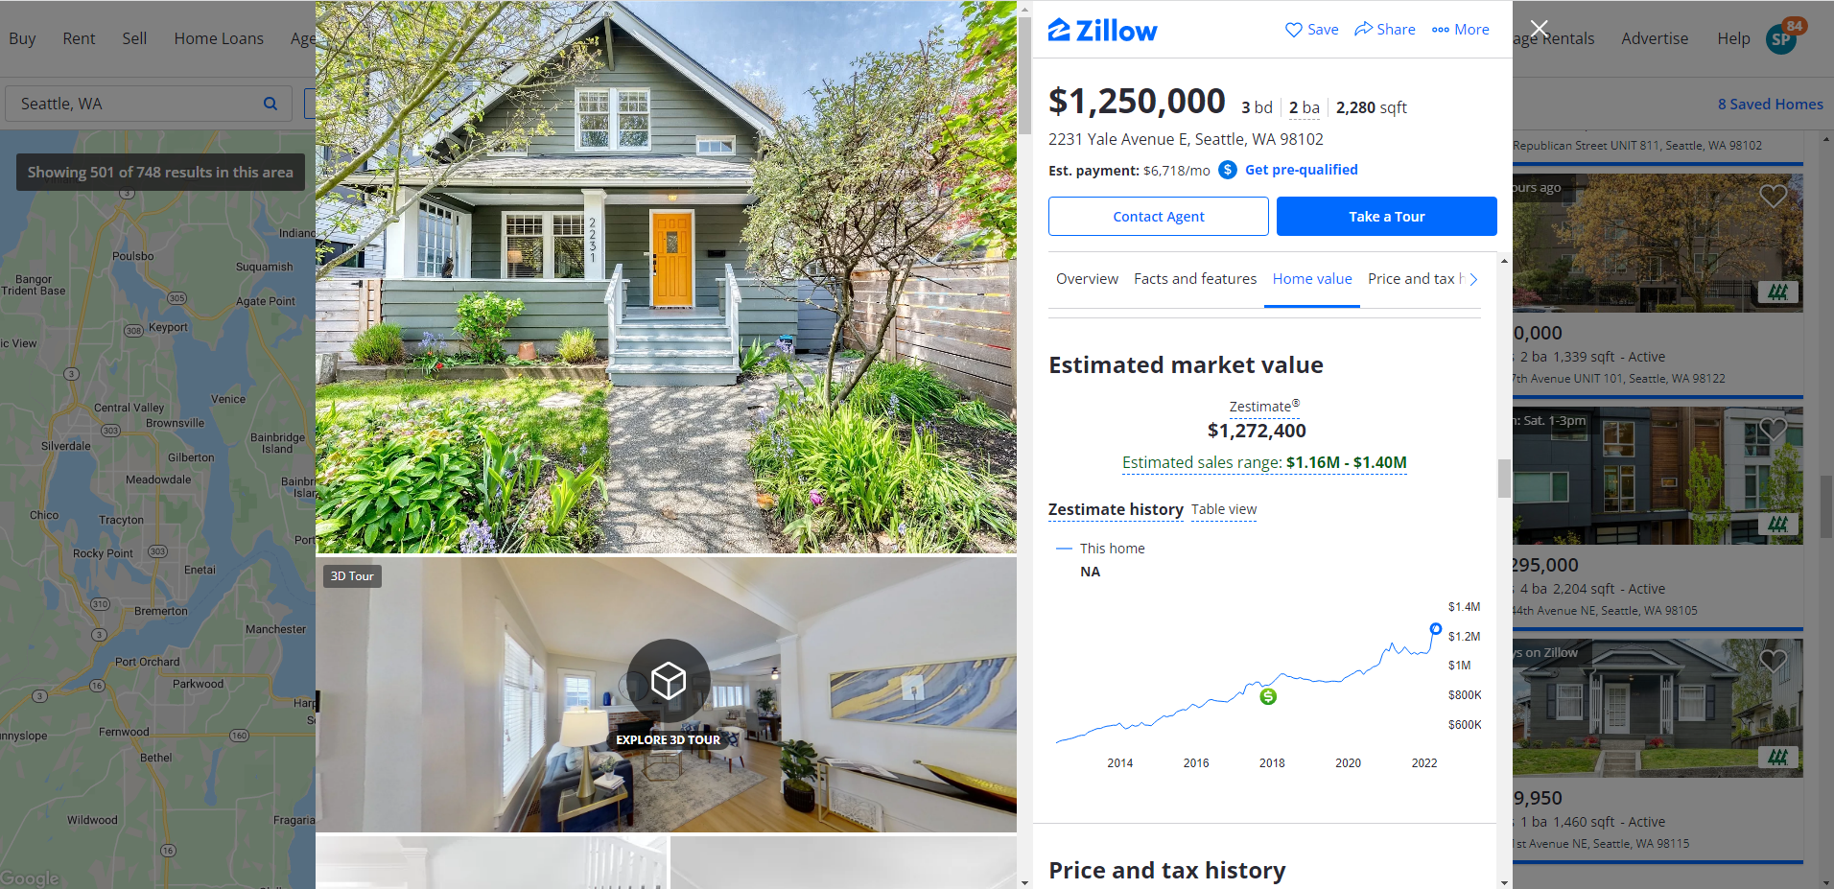
Notes:
Spencer

Slide 3



Notes:
Spencer

Slide 4
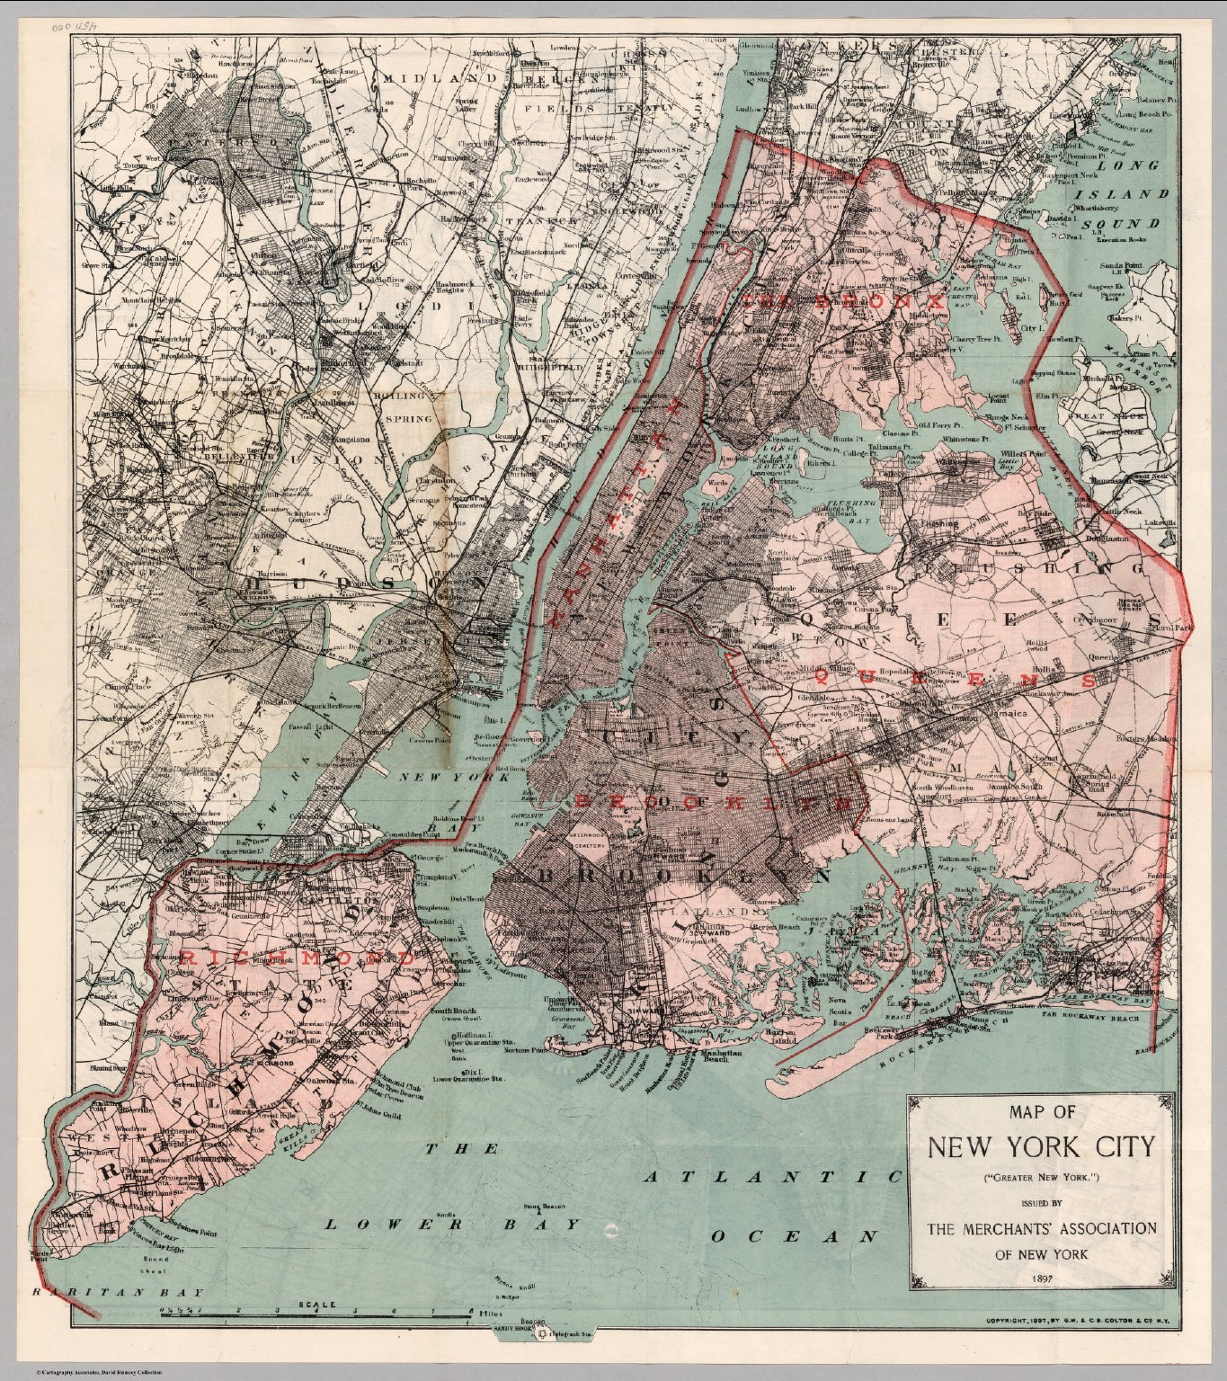
Agenda
Data source
Data adjustments; transformations
Literature review
Variables
Exploratory Data Analysis
Methodology
Data analysis
The final model
Interesting insights
Conclusions; future work
References
Notes:
Spencer
"Hook"
Literature review + the data set + a roadmap (cite source, talk about missing data and transformations, review established work if possible)
Interesting non-regression facts (from chapter 1- descriptive plots (histograms, boxplots, simple hypotheses, and connections like mediation triangle diagrams)
Define variables (Y, Xs, and intuition/logic behind the model)
Methodology (Levels 1-6 pg 64 chapter 4,8 notes or pages 41-42 chapter 5,8 notes. Show work with equations and graphs briefly)
FINAL MODEL (highlight why, define logically, allowed to use technical jargon here like p-values and t-tests)
Interesting insights about final model
Conclusions and future work (relate to original story from first slides, conclusions (avoid technical terms), limitations (biased sampling scheme? Assumptions violated? Multicollinearity?) and future road ahead)
References
Thanks
(from slide framework)

Slide 5





Data Source
01
84,000+ records
NYC Property Sales
02
1,000,000+ data points
03
22 columns
04
8 quantitative variables
City of New York. (December, 2017). NYC Property Sales. Retrieved April 13, 2022 from https://www.kaggle.com/datasets/new-york-city/nyc-property-sales.
04
13 qualitative variables
Notes:
Spencer

Slide 6
Correcting Issues with the Data
Issues:
Missing Sale Price data
Data overload
Wide range of property types
Remedies:
Exclude peculiarities and missing values
Exclude identifying information and complexities like Zip Codes
Narrow to residential buildings
Notes:
Jesse [If I stole this from someone, just let me know and I will return – just making sure all bases covered]
Peculiarities, missing data, transformations

Slide 7
Transformations
Issues:
accounting for location
Range of property types
Sale date
Transformations:
Re-code Boroughs
Narrow to just residential buildings
Rolling Sales Month
Notes:
Jesse [If I stole this from someone, just let me know and I will return – just making sure all bases covered]
Peculiarities, missing data, transformations

Slide 8
Literature Review
General MLS Data Determined to be Great Base for Predicting RE Sale Price
Effects of Neighborhood on House Prices
Effect of Crime Rates in New York City on House Prices
Alternative Findings in School Choice Study Emphasize Interaction Variables
Macro Influence & Bringing the Two Together – Framework for Future Research
Notes:
Jesse
Peculiarities, missing data, transformations

Slide 9
2016-17 NYC Residential Sales Data Variables
Borough, Neighborhood, Address, Zip Code
Building Class (Current, Time of Sale), Tax Class
Location
Building Type
57,312
data points
Gross Square Feet, Land Square Feet
Residential Units, Commercial Units, Total Units
Building Size
Units
Date and Time of Sale
Price of Sale
Sale Date
Sale Price
Notes:
Anna
Talk about difference between gross and land square feet
Difficulty of recoding extensive number of building types

Slide 10


Variables: How to Factor in Location
Address, Zip Code
Too granular
Location
Neighborhood
Too many
Borough
Simple categories
Notes:
Anna

Slide 11

Variables: The Boroughs of NYC
Data Points by Borough
Notes:
Anna
Recoding boroughs

Slide 12
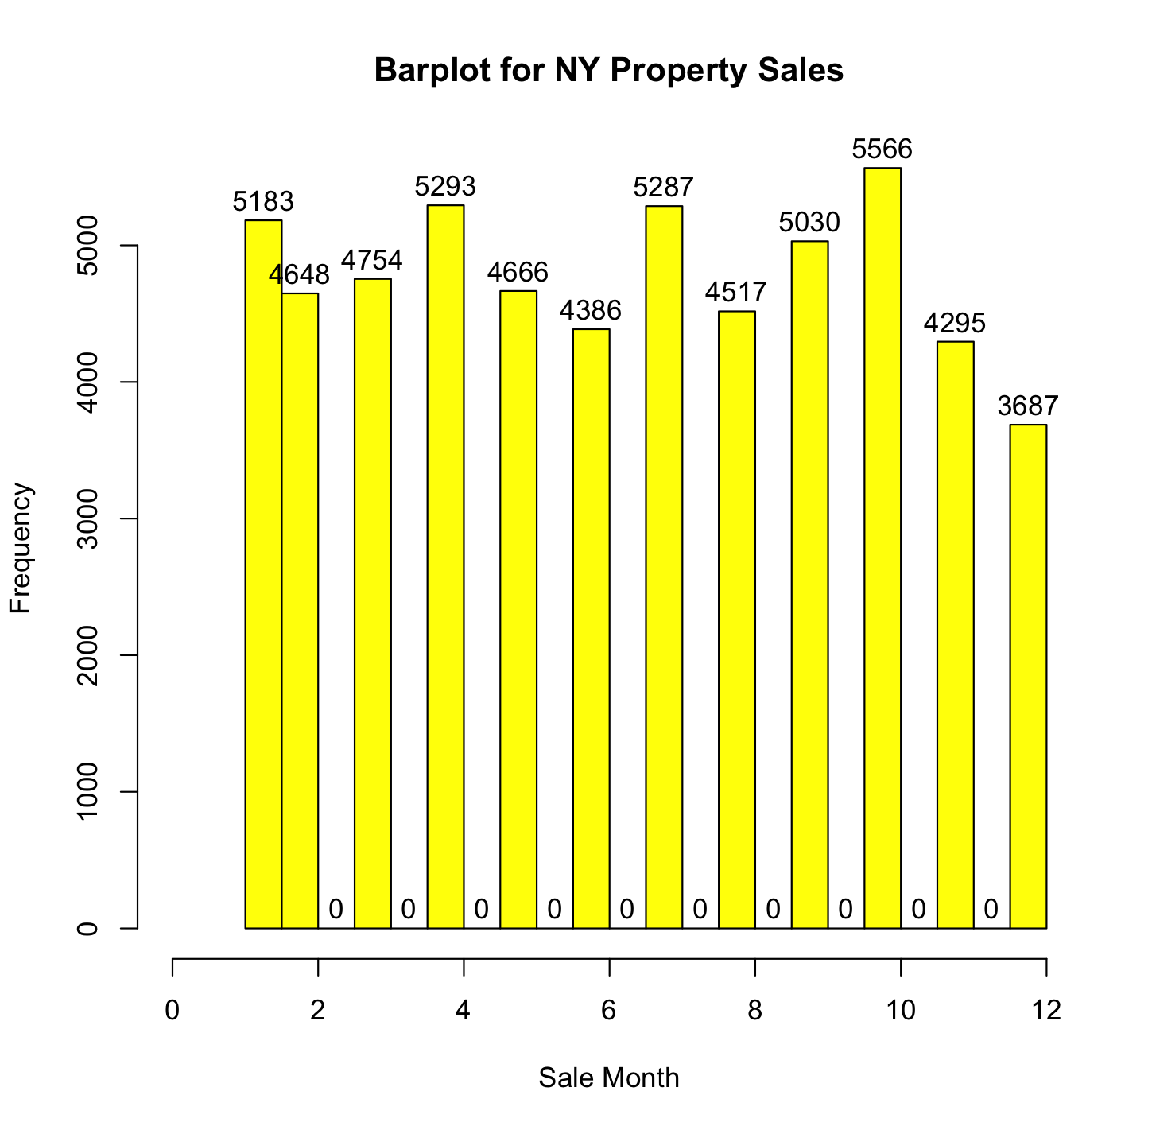
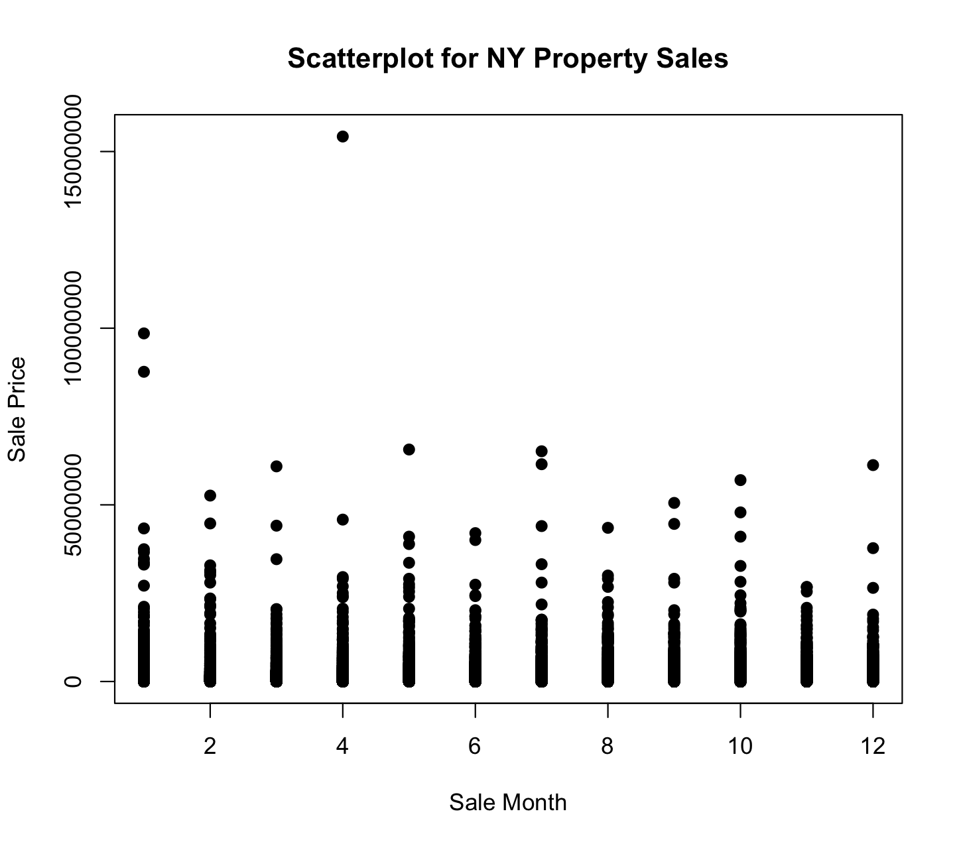
Sale Price by Sale Month
Notes:
Mickey

Slide 13
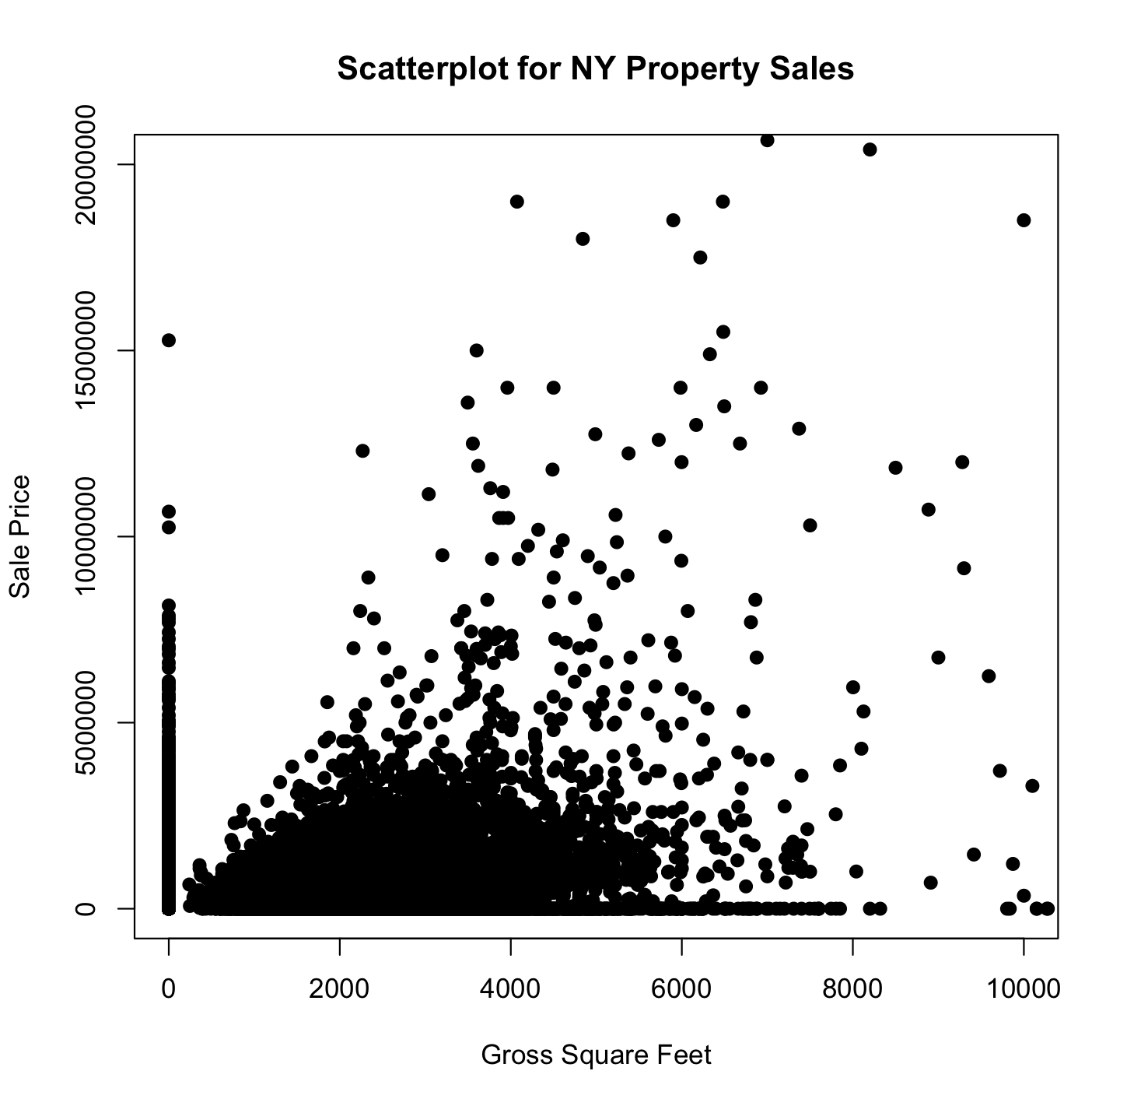
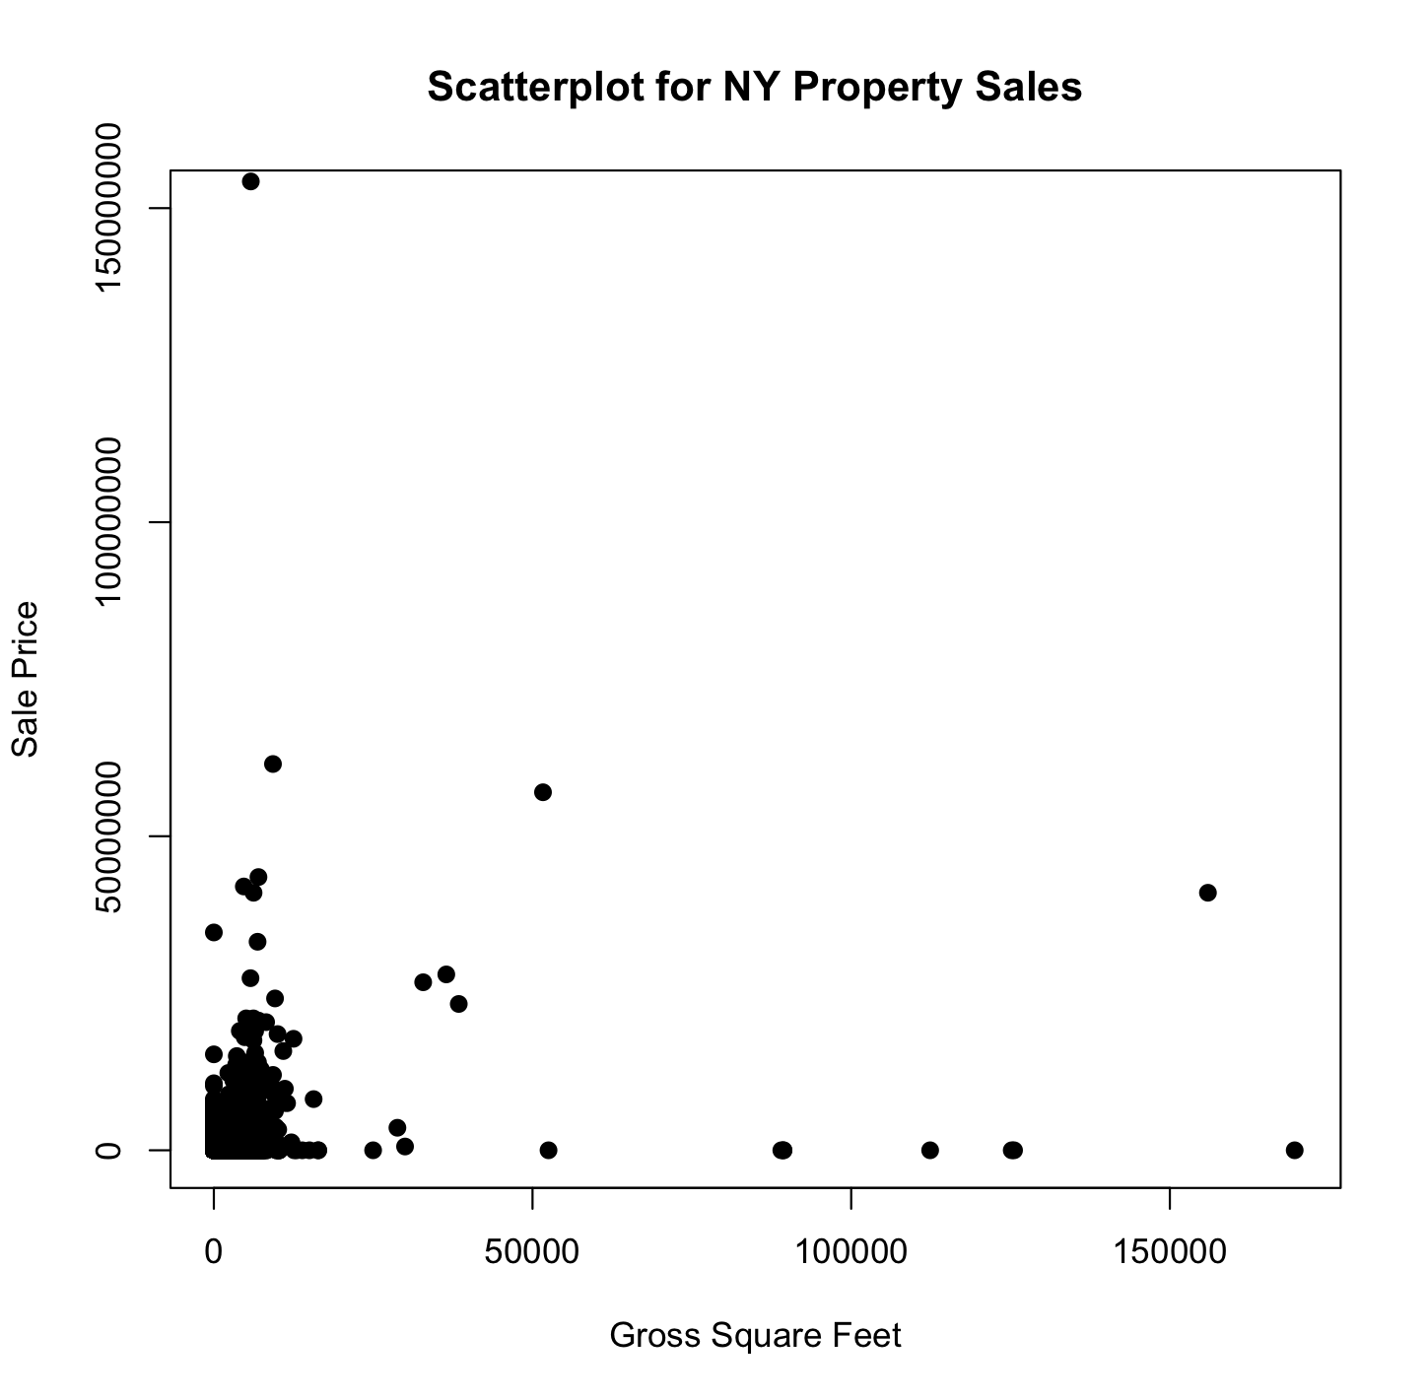
Sales by Gross Square Feet
Notes:
Mickey

Slide 14
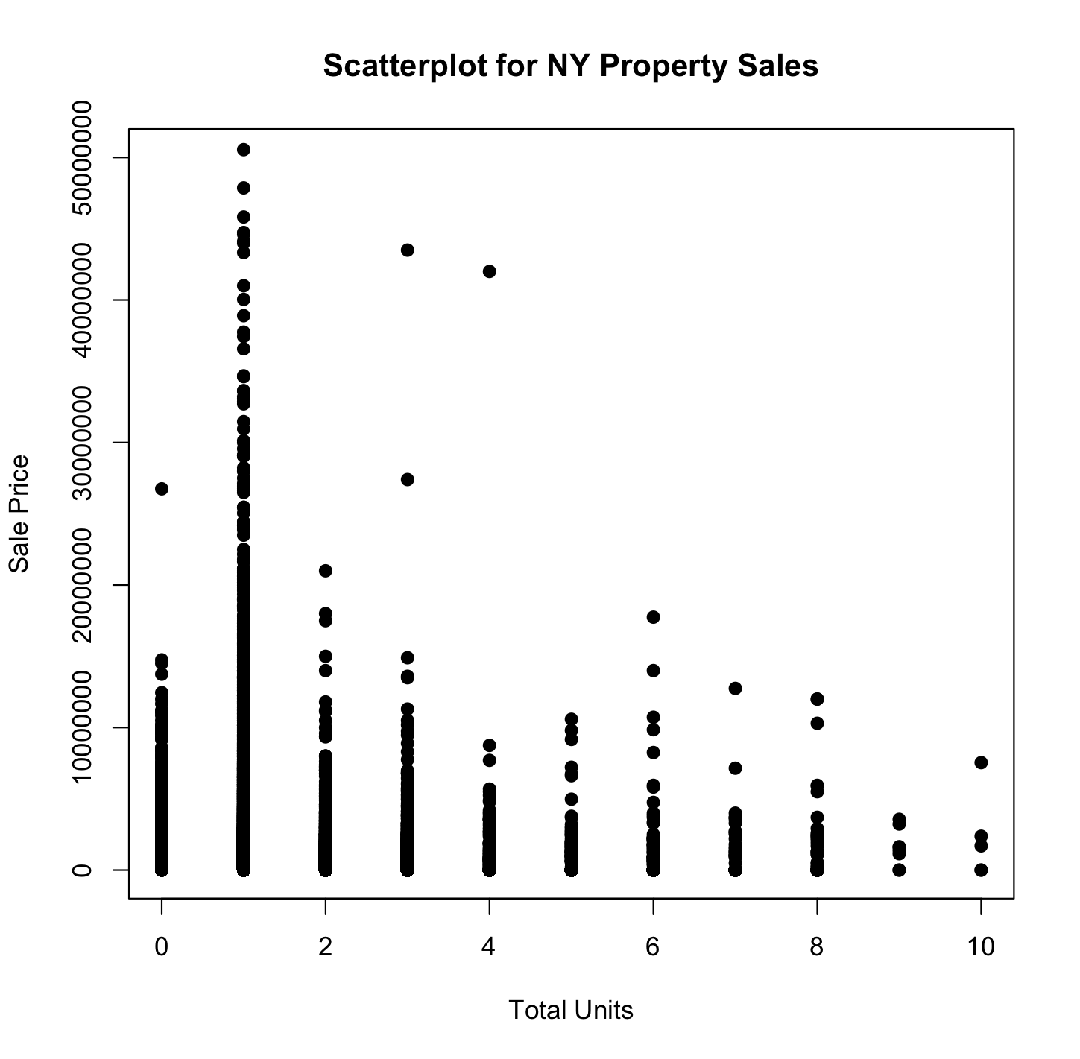
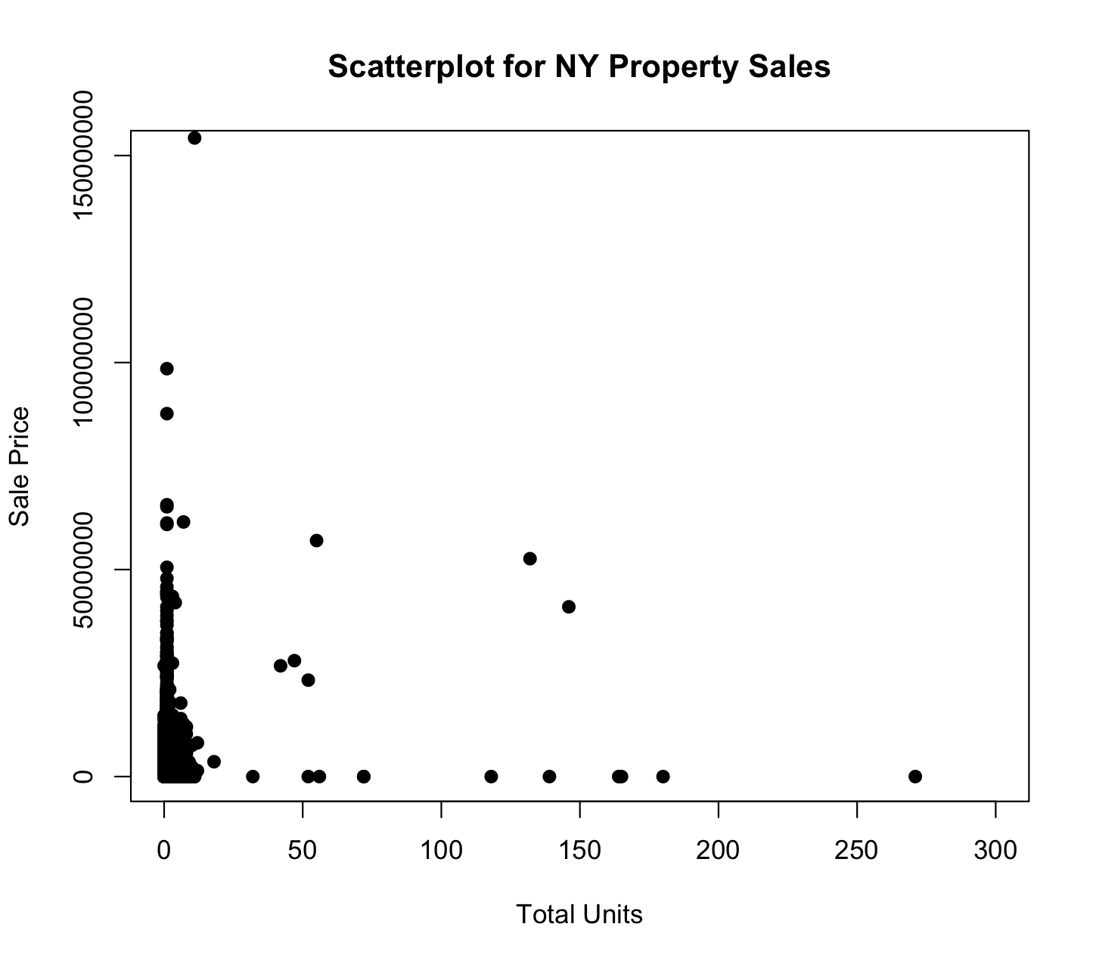
Sales by Total Units
Notes:
Mickey

Slide 15
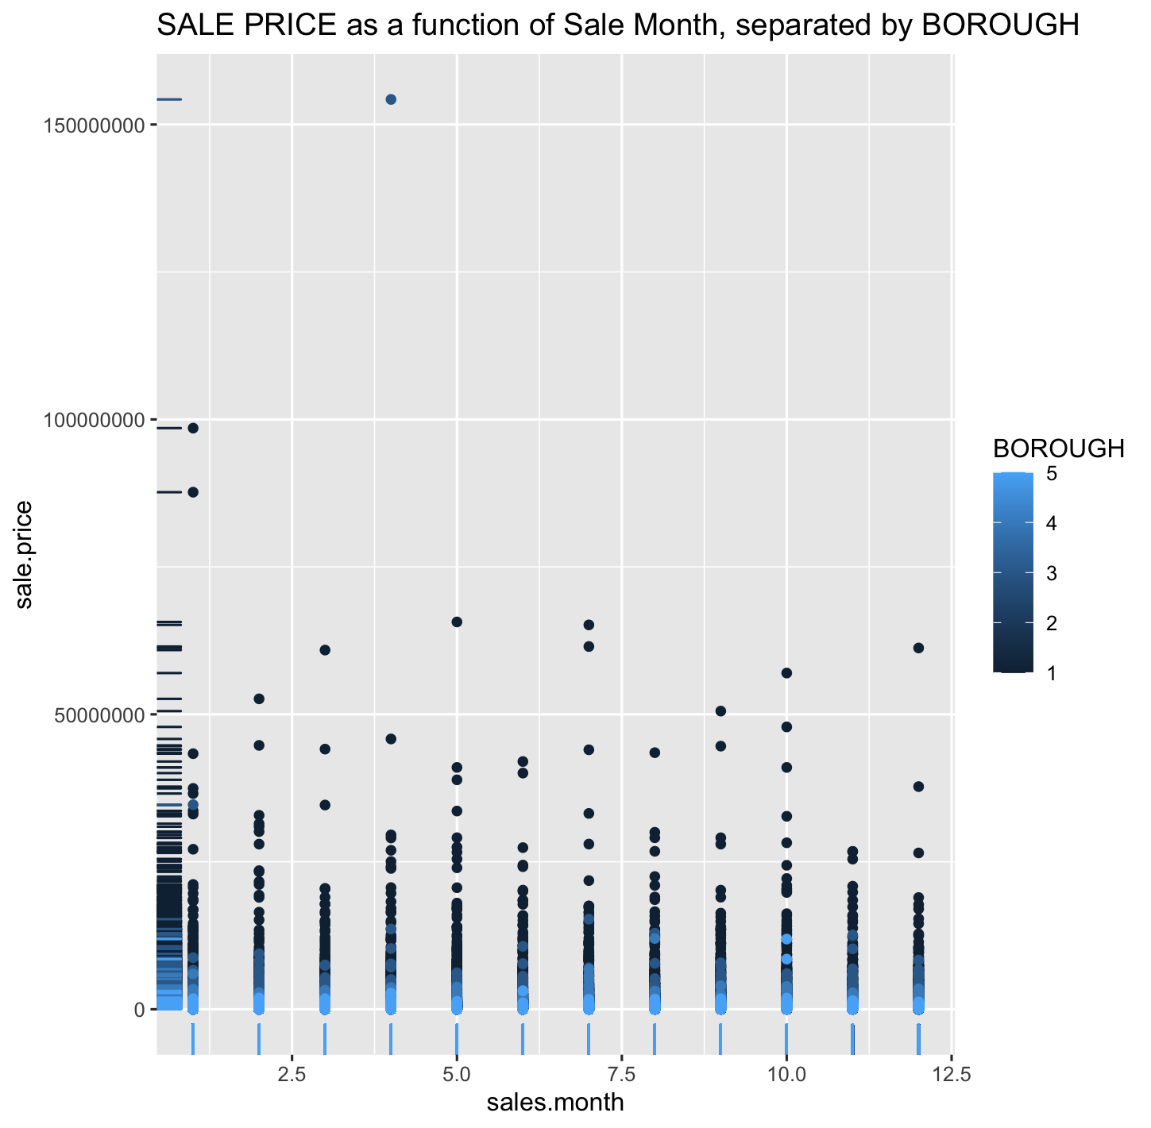
Sales by Borough
Notes:
Mickey

Slide 16
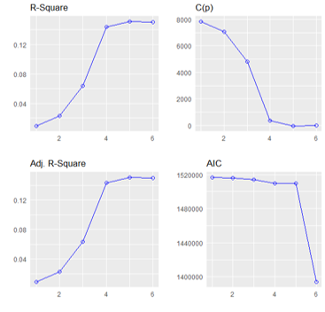
Methodology: Stepwise
PRESS = 9.02e^18
Hypothesis:
H0: B = 0
Ha: B ≠ 0
Included:
(1) Gross Square Feet
(2) Total Units
Recoded Boroughs: (3) Bronx, (4) Brooklyn, (5) Staten Island, (6) Queens
(7) Year Built
(8) Sale price
Notes:
There is no significant difference of any variables on sales price
At least of these variabls has an effect on sales price and is significant
Press value is concerning – big data set
5 VARIABLES ARE SIGNIFICANCE

Slide 17
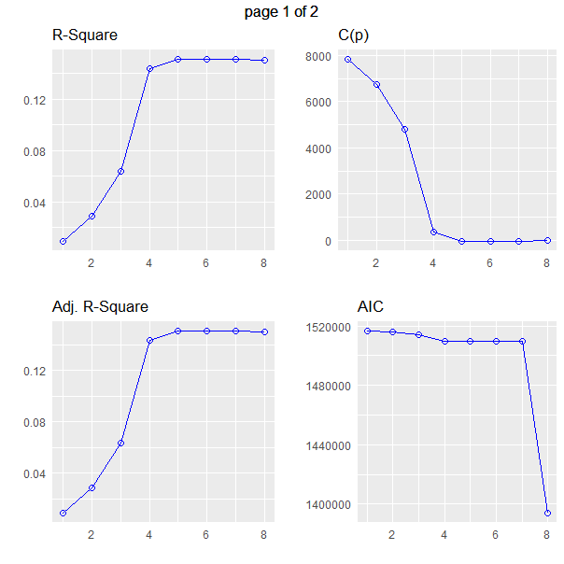
Methodology: Brute Force
Included:
(1) Gross Square Feet
(2) Total Units
Recoded Boroughs: (3) Bronx, (4) Brooklyn, (5) Staten Island, (6) Queens
(7) Sale Price
(8) Year Built
Notes:
We found that model here only requires 7-8 variables ARE SIGNIFICNT

Slide 18
Methodology
Level 1 complexity: Sales Price = f(Gross Square Feet, Total Units, Bronx, Brooklyn, Staten Island, Queens, Year Built)
R_{a}² = ~15%, overall p-value < 0.001, all variable p-values but Year Built < 0.001*
Level 2 complexity: Sales Price = f(Gross Square Feet, Total Units, Bronx, Brooklyn, Staten Island, Queens, Year Built, Gross Square Feet x Total Units)
R_{a}² = ~17%, overall p-value < 0.001, interaction term p-value < 0.001 (lower orders kept by default)
Level 3 complexity: Sales Price = f(Gross Square Feet, Total Units, Bronx, Brooklyn, Staten Island, Queens, Sale Price, Year Built, Gross Square Feet x Total Units, Bronx x Total Units, Brooklyn X Total Units, Staten Island x Total Units, Queens x Total Units)
R_{a}² = 21.39%, overall F p-value < 0.001, all new interaction term p-values < 0.001 (lower orders kept by default)
Notes:
Renata?
*explain rationale behind keeping Year Built – even though it is insignificant here, removing it would not have any effect on say df and affects the p-value but because the sample size is so large, the year built variable becomes negligible
- So borough makes the model more significant – which would make sense because people would pay more in Manhattan than in Staten island and appartments are bigger and more units
ideally would like
- overall p-value for all three levels
- R squared?
- PRESS and SSE for all three levels to calculate R^2 jack

Slide 19
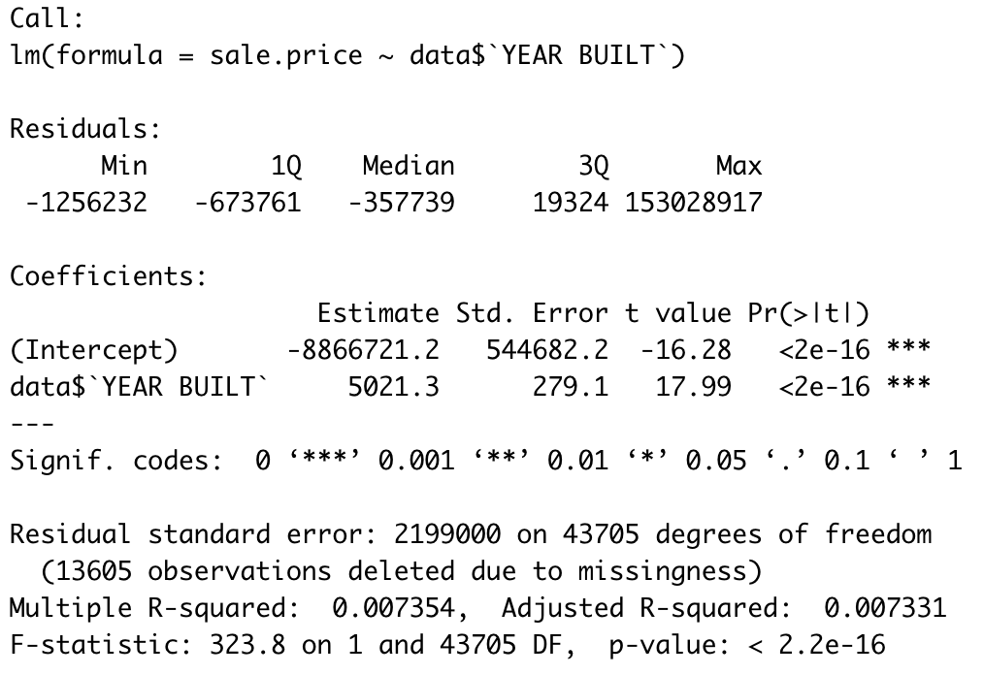
Including “Years Built”
Logically an important part of property evaluation (Maybe not though…)
What other factors could be explaining this?
Notes:
Spencer
It makes sense that a house built yesterday is going to sell for more than a house built 20 years ago
Simple regression – it is significant p-value
But when other variables are added, then it becomes insignificant

Slide 20
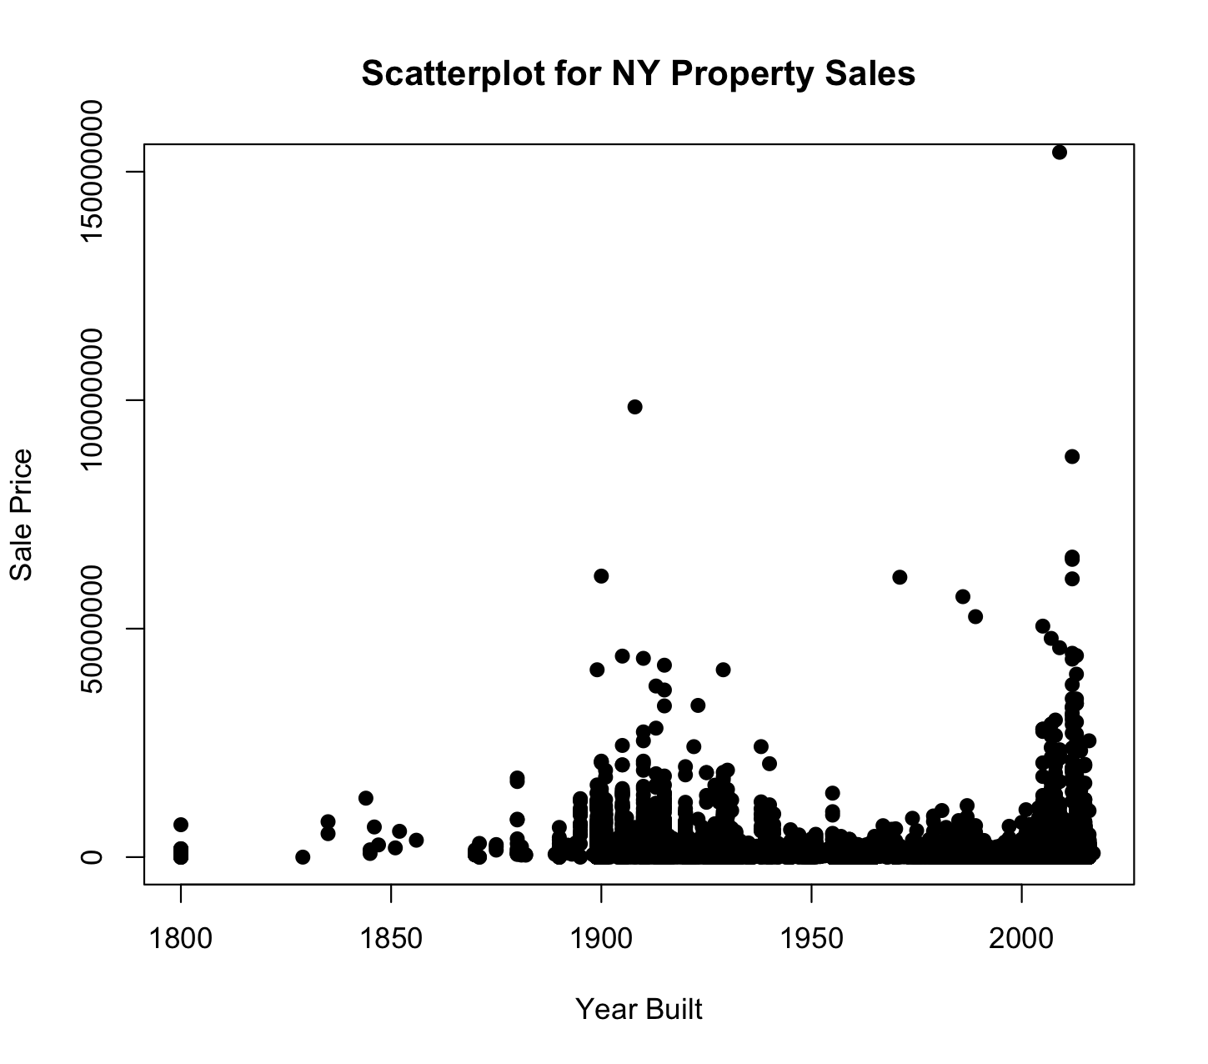
Notes:
Spencer
But these are not linear variables and three is no linear relationship because we cannot explain with the model why there are peaks in 1900 and 2000
This is due to other factors such as renovation of historical buildings and are highly desirable.

Slide 21
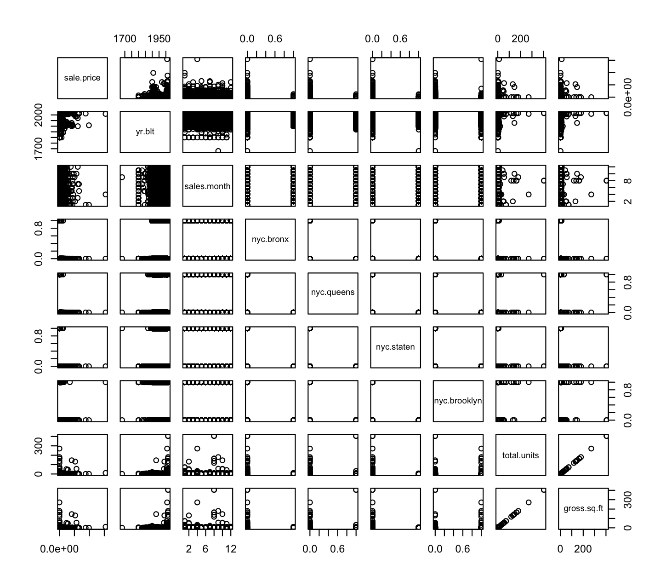
Data-based Multicollinearity
Notes:
???

Slide 22
Data-based Multicollinearity
Strong Positive Correlation
Between
Total Units & Gross.Sq.Ft
Notes:
???

Slide 23
Mediation Models
x7x1
x9x5
Gross Square Feet
Total Units
Total Units
Sale Price
x14x15
Bronx
Sale Price
Total Units
x4x2
x11x6
Total Units
Queens
Sale Price
Total Units
Brooklyn
Sale Price
Staten
Sale Price
Notes:
???

Slide 24
9 Point Check List for Final Model
High R2, Adjusted R2 (1)
Small MSE (2)
Overall F-Test (3)
Individual T-test (4)
Good Residuals (5)
Logical (6)
Compact Interval (7)
Low Press(High R2 Jack) (8)
No Multicollinearity-VIF<10 (9)
Notes:
Mickey

Slide 25
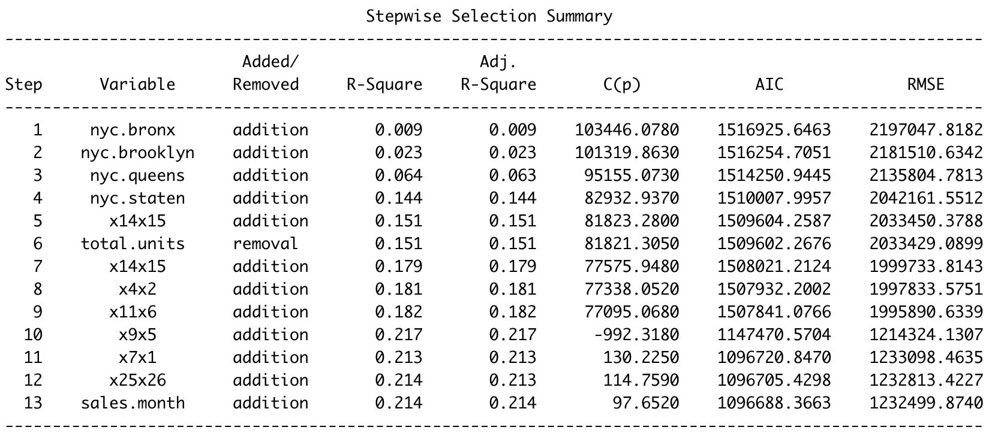

Slide 26
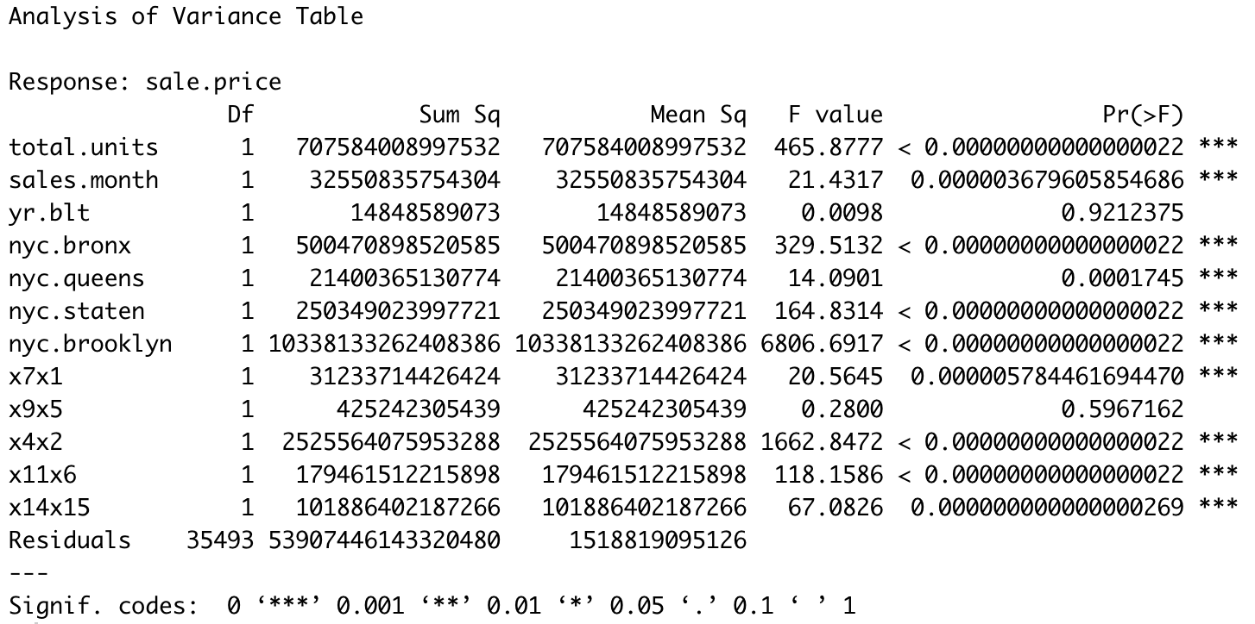
MSE

Slide 27
9 Point Check List for Final Model
High R2, Adjusted R2 (1)
Small MSE (2)
Overall F-Test (3)
Individual T-test (4)
Good Residuals (5)
Logical (6)
Compact Interval (7)
Low Press(High R2 Jack) (8)
No Multicollinearity-VIF<10 (9)
Highest Adjusted R2
Small MSE
Accepted Null Hypothesis (Significant)
Accepted Null Hypothesis (Significant)
Good
Logical
Not So Compacted
Press(Unknown for the moment)
No Multicollinearity-UIF<10 (9)

Slide 28
9 Point Check List for Final Model
High R2, Adjusted R2 (1)
Small MSE (2)
Overall F-Test (3)
Individual T-test (4)
Good Residuals (5)
Logical (6)
Compact Interval (7)
Low Press(High R2 Jack) (8)
No Multicollinearity-VIF<10 (9)
Highest Adjusted R2
Small MSE
Accepted Null Hypothesis (Significant)
Accepted Null Hypothesis (Significant)
Good
Logical
Not So Compacted
Press(Unknown for the moment)
No Multicollinearity-UIF<10 (9)

Slide 29
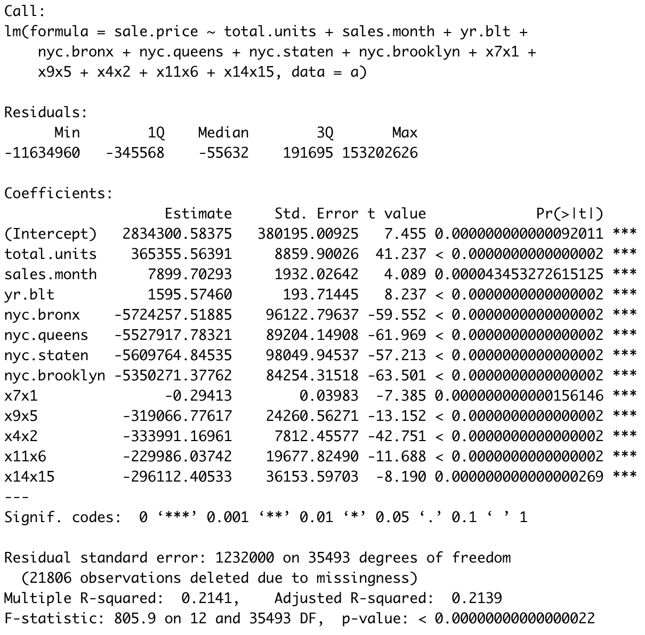

Slide 30
9 Point Check List for Final Model
High R2, Adjusted R2 (1)
Small MSE (2)
Overall F-Test (3)
Individual T-test (4)
Good Residuals (5)
Logical (6)
Compact Interval (7)
Low Press(High R2 Jack) (8)
No Multicollinearity-VIF<10 (9)
Highest Adjusted R2
Small MSE
Accepted Null Hypothesis (Significant)
Accepted Null Hypothesis (Significant)
Good
Logical
Not So Compacted
Press(Unknown for the moment)
No Multicollinearity-UIF<10 (9)

Slide 31
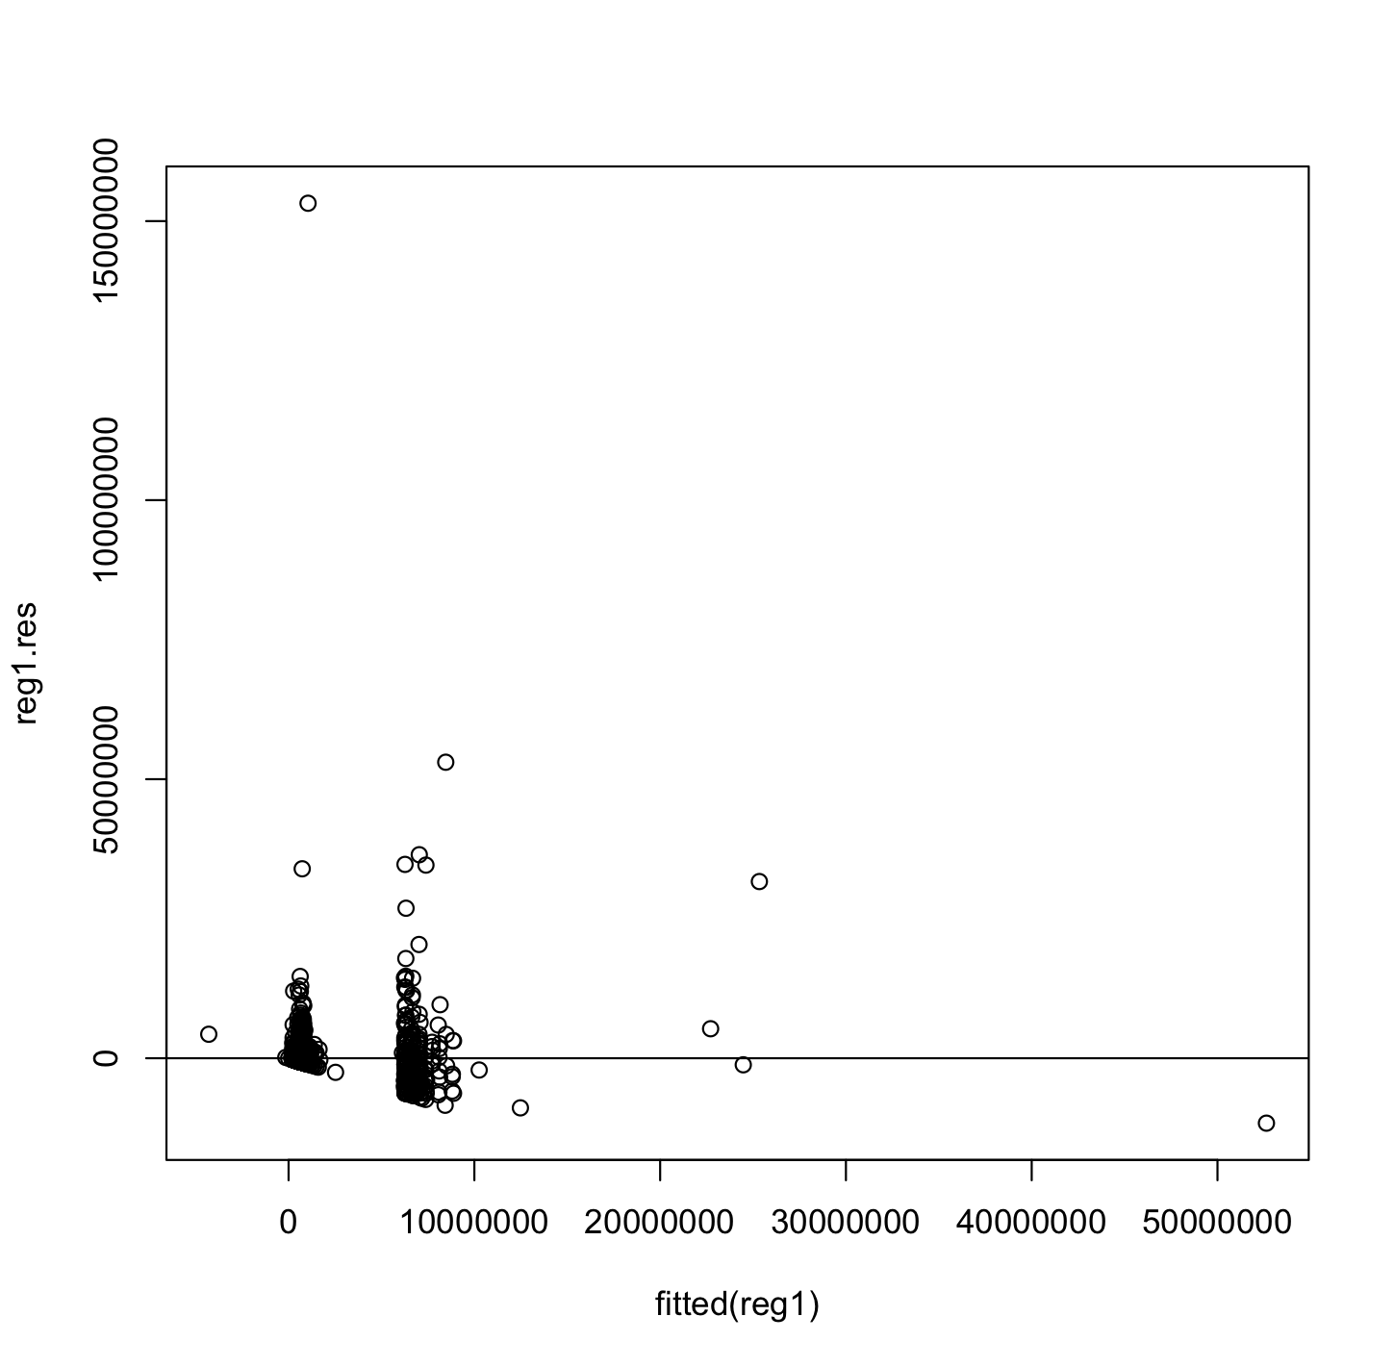
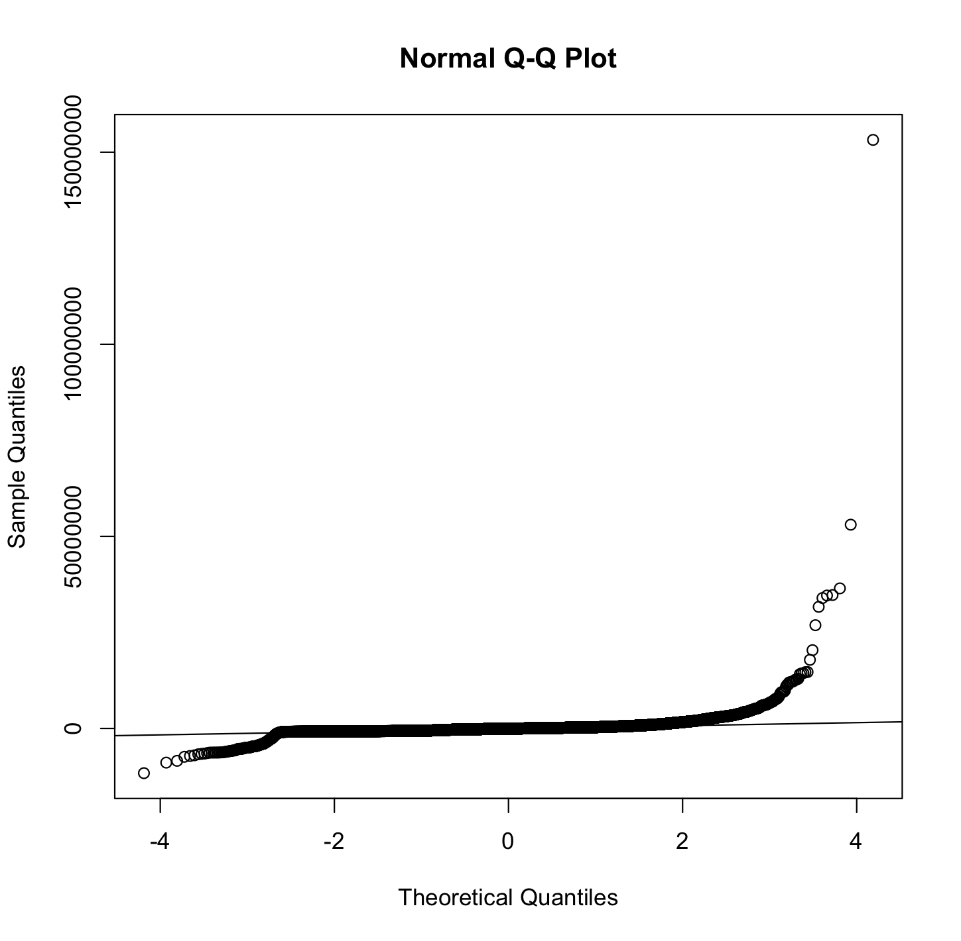
Residual vs. Fitted Plot

Slide 32
9 Point Check List for Final Model
High R2, Adjusted R2 (1)
Small MSE (2)
Overall F-Test (3)
Individual T-test (4)
Good Residuals (5)
Logical (6)
Compact Interval (7)
Low Press(High R2 Jack) (8)
No Multicollinearity-VIF<10 (9)
Highest Adjusted R2
Small MSE
Accepted Null Hypothesis (Significant)
Accepted Null Hypothesis (Significant)
Good
Logical
Not So Compacted
Press(Unknown for the moment)
No Multicollinearity-UIF<10 (9)

Slide 33
Sale Price by Sale Month

Slide 34
Sales by Gross Square Feet

Slide 35
Sales by Total Units

Slide 36
Sales by Borough

Slide 37
9 Point Check List for Final Model
High R2, Adjusted R2 (1)
Small MSE (2)
Overall F-Test (3)
Individual T-test (4)
Good Residuals (5)
Logical (6)
Compact Interval (7)
Low Press(High R2 Jack) (8)
No Multicollinearity-VIF<10 (9)
Highest Adjusted R2
Small MSE
Accepted Null Hypothesis (Significant)
Accepted Null Hypothesis (Significant)
Good
Logical
Not So Compacted
Press(Unknown for the moment)
No Multicollinearity-UIF<10 (9)

Slide 38
Data-based Multicollinearity
Strong Positive Correlation
Between
Total Units & Gross.Sq.Ft

Slide 39
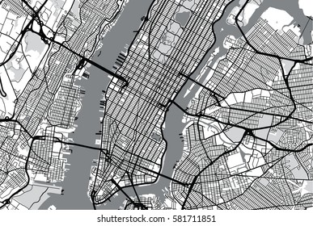
Conclusion
Zillow had issues with their Zestimate feature and struggled to rely on it for offer amounts
Complexities in predicting real estate values
Need to consider macro trends and other factors
The factors we tested for are significant in predicting the sale price and value of the properties
We need more data
Notes:
Kirat
We can see why Zillow had issues with their Zestimate feature and struggled to rely on it for offer amounts
With so many factors and abnormalities in sale price it is impossible to leave the value of a property to an algorithm let alone a regression model
Have to consider macro trends like the state of the economy, job market, school system, and other things people look at when buying a home
These are difficult to account for
However, this is a good start and provides reasonable ranges… The factors that we included in our model were deemed significant to predicting sale prices meaning these factors are important in the sale price
More factors would likely need to be included to improve predictions

Slide 40
Limitations
Location specific to NYC
Can’t reliably predict the value without more data points and factors
Notes:
Kirat

Slide 41
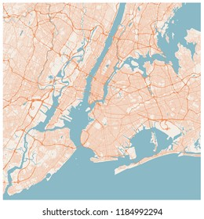
Future Research
Macro data/variables along with common RE data
Bringing the two together in a method that best predicts the sale price of the property
Model should allow for more variation to be explained and will be a greater predictor of sale price.
See if the model can take data from future years i.e 2018
Effects of pandemic and great resignation on sale price in NYC boroughs
Notes:
Kirat
Macro data/variables along with common RE data
Bringing the two together in a method that best predicts the sale price of the property
Model should allow for more variation to be explained, and will be a greater predictor of sale price.
See if the model can take data from future years i.e 2018
Effects of pandemic and great resignation on sale price in NYC boroughs

Slide 42
Thank you! Questions/Comments?
Notes:
Spencer

Slide 43
Citations
Dubin, R. A. (1998). Predicting house prices using multiple listings data. The Journal of Real Estate Finance and Economics, 17(1), 35-59.
Himmelberg, C., Mayer, C., & Sinai, T. (2005). Assessing high house prices: Bubbles, fundamentals and misperceptions. Journal of Economic Perspectives, 19(4), 67-92.
Schwartz, A. E., Susin, S., & Voicu, I. (2003). Has falling crime driven New York City's real estate boom?. Journal of Housing Research, 101-135.
Schwartz, A. E., Voicu, I., & Horn, K. M. (2014). Do choice schools break the link between public schools and property values? Evidence from house prices in New York City. Regional Science and Urban Economics, 49, 1-10.
Tse, R. Y. (2002). Estimating neighbourhood effects in house prices: towards a new hedonic model approach. Urban studies, 39(7), 1165-1180.
Zhang, L. (2016). Flood hazards impact on neighborhood house prices: A spatial quantile regression analysis. Regional Science and Urban Economics, 60, 12-19.

